Slide 1
Object Oriented Programming
Asst.Prof.Dr.Derya BİRANT
329 - Windows Programming

Slide 2
Contents
1
Object Oriented Programming
2
Basic Concepts
3
Namespaces
4
Examples

Slide 3
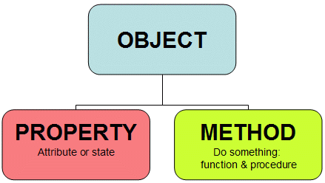
Object Oriented Programming
Object-oriented programming is a method of programming based on a hierarchy of classes, and well-defined and cooperating objects.

Slide 4
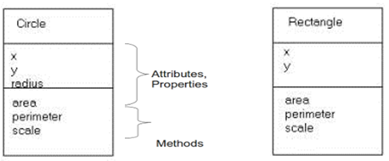
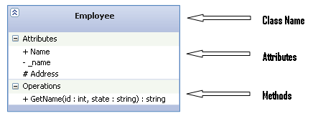
Basic Concepts
A class is capable of storing data and actions.
An object is referred to as an instance of the class data type.
Fields: Variables declared for use within the class, often for storing data.
Constructors: Special procedures that are called to create an object using the class.
Methods: Procedures that provide the behaviors of the class.
Properties: Procedures that provide access to the class’ data structure.

Slide 5
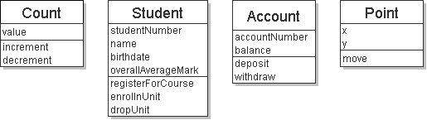
Examples

Slide 6
Namespaces
Namespaces organize groups of related classes.
Each class’s name is actually a combination of its namespace name, a dot (.) and the class name.

Slide 7
Namespaces
Permits isolation of names
(Two different namespaces can contain a class with the same name)
Can be nested
Access via fully qualified names
Namespace CS415
Class A
Class B
Class C
Namespace CS340
Class A
Class B
Class C
CS415.A…
CS340.A…

Slide 8
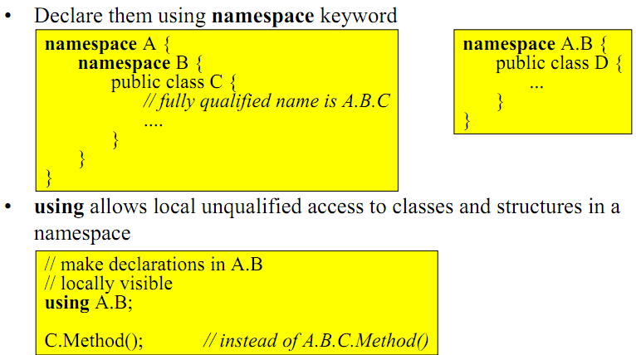
Hierarchical Namespaces
Classes are organized into hierarchical namespaces

Slide 9
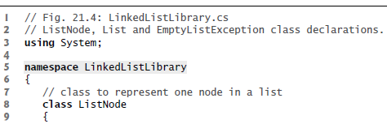
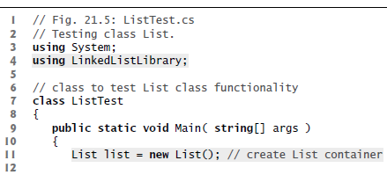

…
…
…
…
…

Slide 10
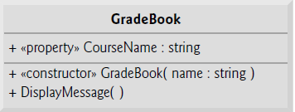
Example
class GradeBook
{
private string courseName; // course name for this GradeBook
public GradeBook()
{
}
public GradeBook(string name)
{
CourseName = name; // set CourseName to name
} // end constructor
// property to get and set the course name
public string CourseName
{
get
{
return courseName;
} // end get
set
{
courseName = value;
} // end set
} // end property CourseName
public string DisplayMessage()
{
return "Welcome to the grade book for " + courseName;
}
}

Slide 11

private void button1_Click(object sender, EventArgs e)
{
// invokes constructor
GradeBook gradeBook1 = new GradeBook("CS101 Introduction to C#
Programming");
MessageBox.Show(gradeBook1.DisplayMessage());
GradeBook gradeBook2 = new GradeBook("CS102 Data Structures in C#");
MessageBox.Show(gradeBook2.DisplayMessage());
GradeBook myGradeBook = new GradeBook();
myGradeBook.CourseName = textBox1.Text;
MessageBox.Show(myGradeBook.DisplayMessage());
}

Slide 12
class Account
{
private decimal balance; // instance variable that stores the balance
// constructor
public Account(decimal initialBalance)
{
Balance = initialBalance; // set balance using property
} // end Account constructor
// credit (add) an amount to the account
public void Credit(decimal amount)
{
Balance = Balance + amount; // add amount to balance
} // end method Credit
// a property to get and set the account balance
public decimal Balance
{
get
{
return balance;
} // end get
set
{
// validate that value is greater than or equal to 0;
// if it is not, balance is left unchanged
if (value >= 0)
balance = value;
}
}
}
Example

Slide 13
private void button1_Click(object sender, EventArgs e)
{
Account account1 = new Account(50);
Account account2 = new Account(7);
account1.Credit(15);
MessageBox.Show(account1.Balance.ToString());
}

Slide 14

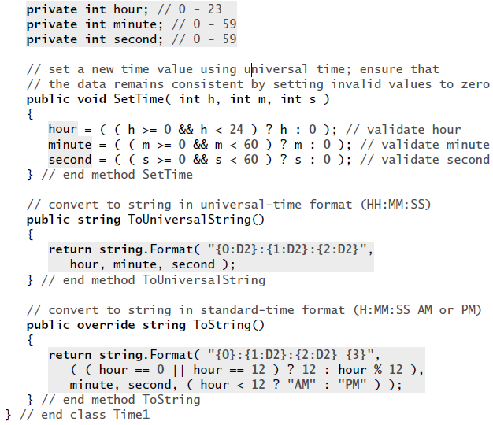
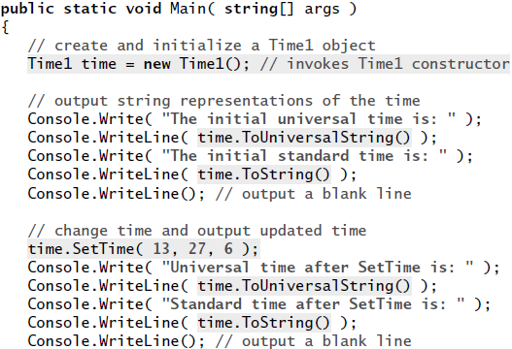


Slide 15
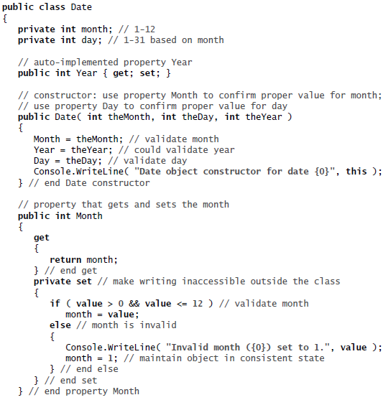

Slide 16
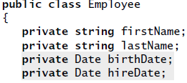
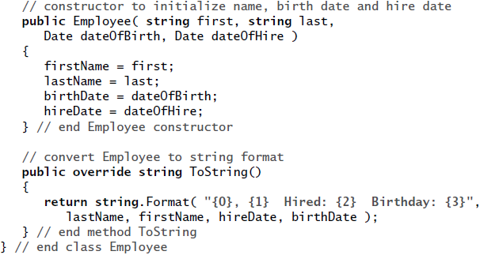
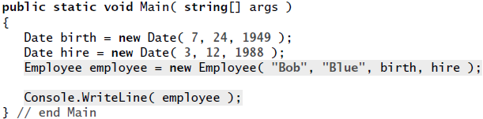


Slide 17
Example (1/12)
Add new class Point (Project > Add class)
class Point
{
private int _x;
private int _y;
public Point(int x, int y)
{
_x = x;
_y = y;
}
}

Slide 18
Example (2/12)
Write get / set methods
public int X
{
get { return _x; }
set { _x = value; }
}
public int Y
{
get { return _y; }
set { _y = value; }
}

Slide 19
Example (3/12)
Move Point one place in X and Y direction
public void Move( ) // declare public
{
_x++; // move X by one
_y++; // move Y by one
}
public void Move(int Xdistance, int Ydistance)
{
_x = _x + Xdistance;
_y = _y + Ydistance;
}
myPoint.Move(12,34); // pass X and Y
myPoint.Move( ); // one unit in X and Y

Slide 20
Example (4/12)
Override default ToString method.
public override string ToString( )
{
return "My Point Object is at : " + _x + “," + _y;
}
Use:
MessageBox.Show(MyPoint.ToString( ));
Displays:
‘My Point Object is at : 123,456’

Slide 21
Example (5/12)
Static Classes:
  don’t have to be instantiated
  available to all objects
class Calculate // pass x,y return distance
{
public static double DistanceToOrigin(int x, int y)
{
return Math.Sqrt(x * x + y * y);
}
}
Use:
distance = Calculate.DistanceToOrigin (myPoint.X, myPoint.Y);

Slide 22
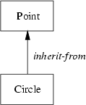
Example (6/12)
Inheritance:
  Take a class and extend
Example:
  Let’s create Circle Class from our Point Class
  Circle class that inherits from class Point.
  Can add radius and area
  Code: public Circle : Point

Slide 23
Example (7/12)
Add new class Circle: (Project > Add class)
class Circle : Point
{
}
Can now create a circle:
Circle smallcircle = new Circle( );
Because we are using existing code, it’s more reliable

Slide 24
Example (8/12)
Extend – define radius
Constructors:
class Circle : Point
{
private double _radius; // internal – private
public Circle() : this(0,0,0) { }
public Circle(int x, int y) : this(x, y, 0) { }
// _x and _y now declared protected in Point class
// still private to outside world
public Circle(int x, int y, int r) : base(x, y) {
_radius = r;
}

Slide 25
Example (9/12)
// add property - radius – use get and set
public double radius
{
get
{
return _radius;
}
set
{
if (value >= 0)
_radius = value;
}
}

Slide 26
Example (10/12)
Extend further
Add method – Area:
// method Area
public double area( )
{
return Math.PI * _radius * _radius;
}

Slide 27
Example (11/12)
Override ToString method:
public override string ToString()
{
return "Circle at x,"+_x+" y,"+ "radius,"+_radius;
}

Slide 28
Example (12/12)
Use:
Point myPoint = new Point(3,5);
myPoint.Move();
MessageBox.Show(myPoint.ToString());
myPoint.Move(3,4);
MessageBox.Show(myPoint.ToString());
double distance = Calculate.DistanceToOrigin(myPoint.X, myPoint.Y);
MessageBox.Show(distance.ToString());
Circle smlCircle = new Circle( );
Circle largeCircle = new Circle(12, 34, 56);
smlCircle.X = 98;
smlCircle.Y = 87;
smlCircle.Radius = 10;
MessageBox.Show(smlCircle.ToString( ));
MessageBox.Show(largeCircle.ToString( ));
MessageBox.Show (smlCircle.area( ).ToString( ));

Slide 29
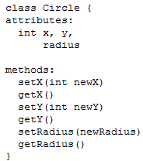
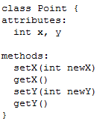

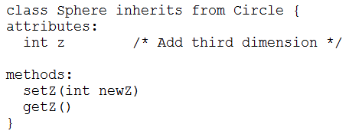
Example

Slide 30
See you next week!
Asst.Prof.Dr.Derya BİRANT
329 - Windows Programming

